Slide 1
INTRODUCTION TO UI/UX DESIGN

Slide 2
UI – User Interface UX – User Experience

Slide 3
“A UI without UX is like a painter slapping paint onto canvas without thought; while UX without UI is like the frame of a sculpture with no paper mache on it.”

Slide 4
Put simply.
User Experience Design focuses on how the user thinks and feels. User Interface Design looks at how the content is organized and used.
Or
A door handle is UI Design. The fact you need a door is UX Design.

Slide 5
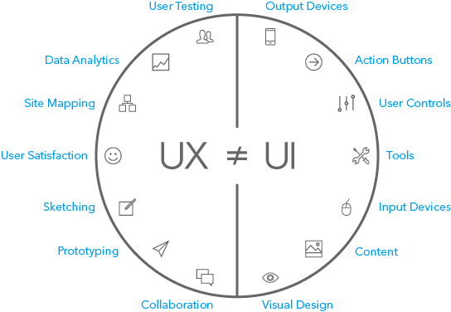

Slide 6
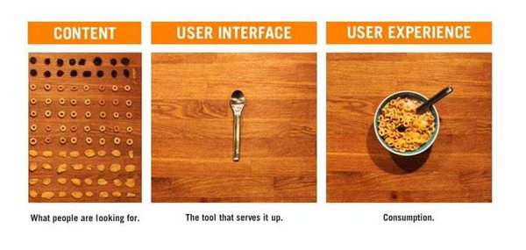

Slide 7
THE DESIGN PROCESS

Slide 8

Identifying Problem Statement and Target Crowd

Slide 9
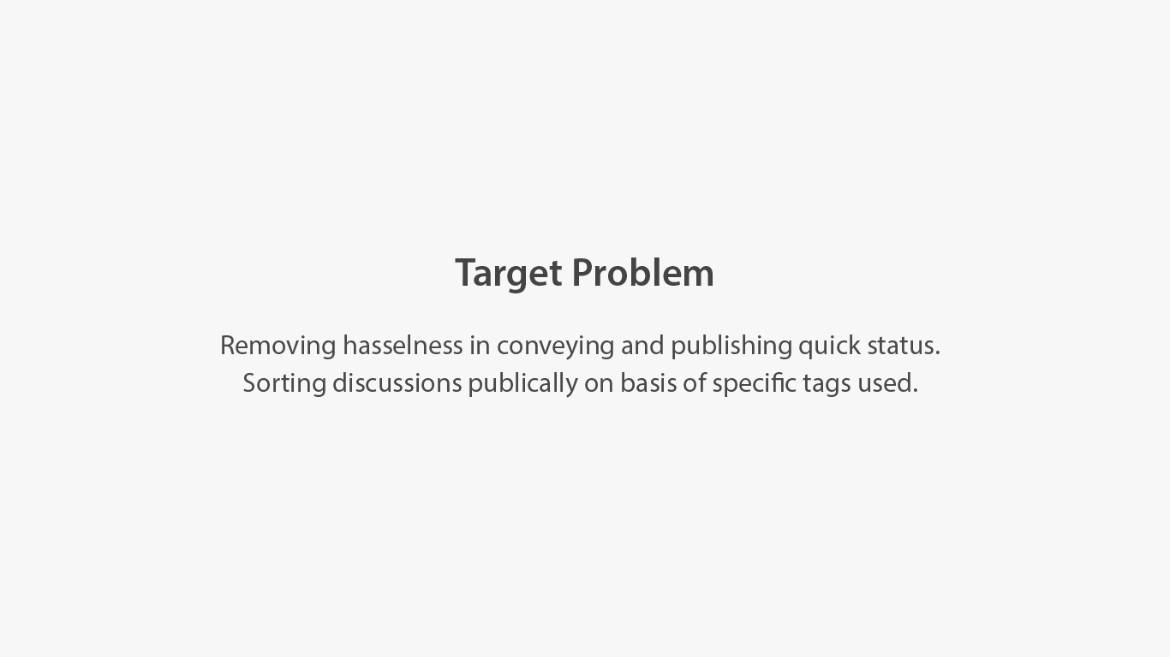

Slide 10
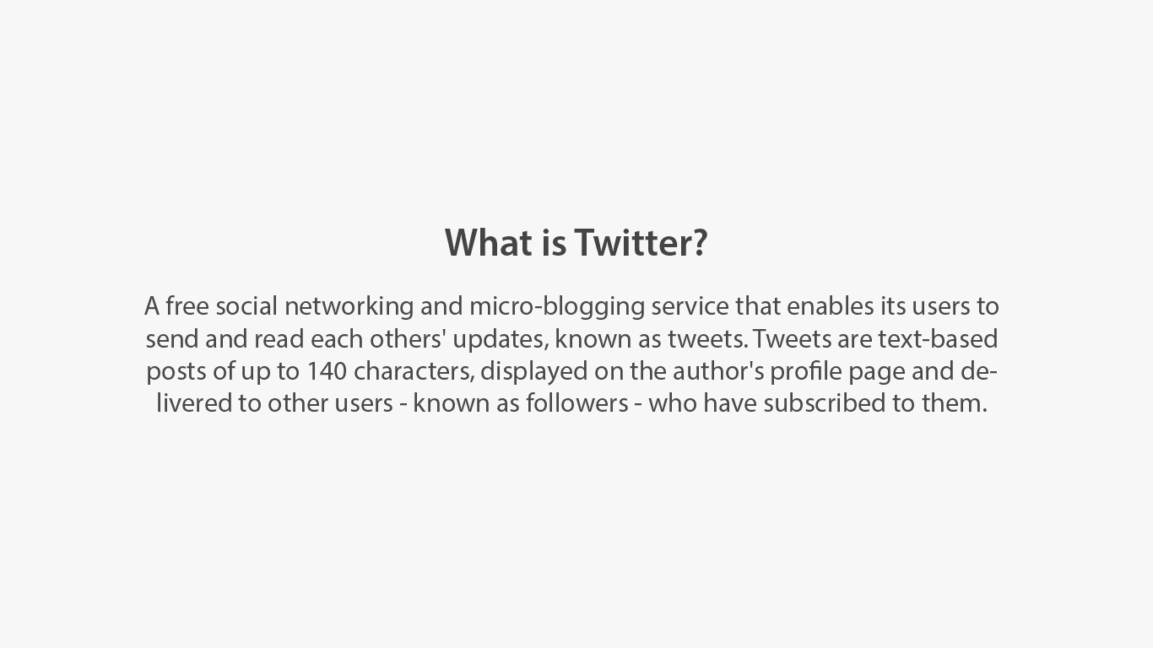

Slide 11
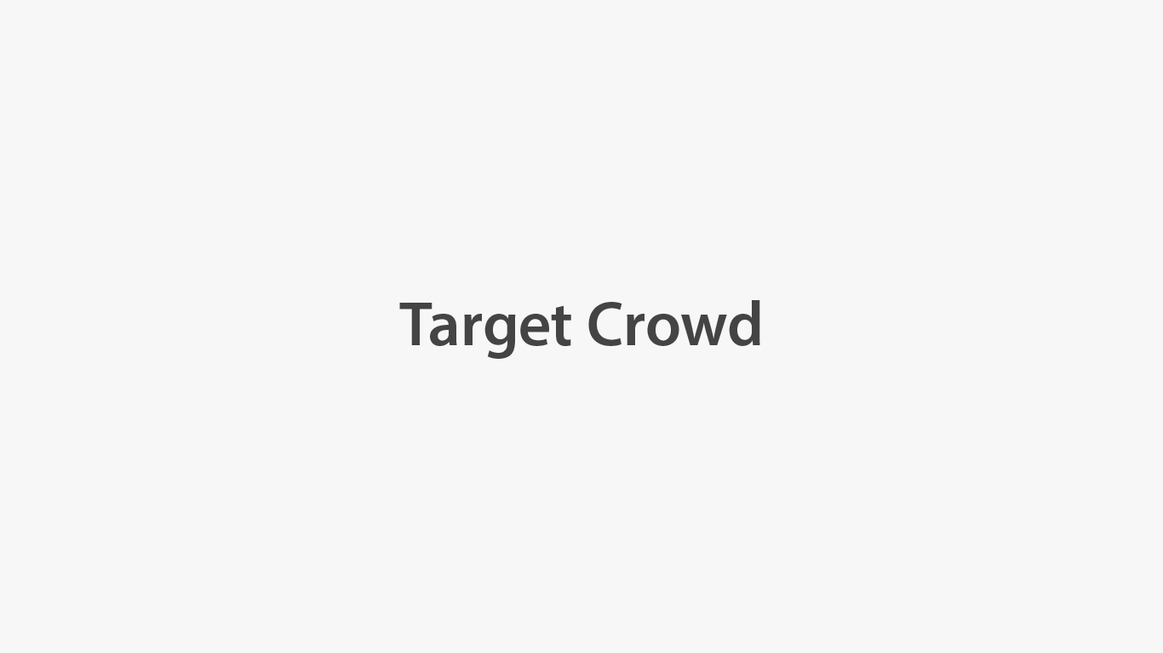

Slide 12
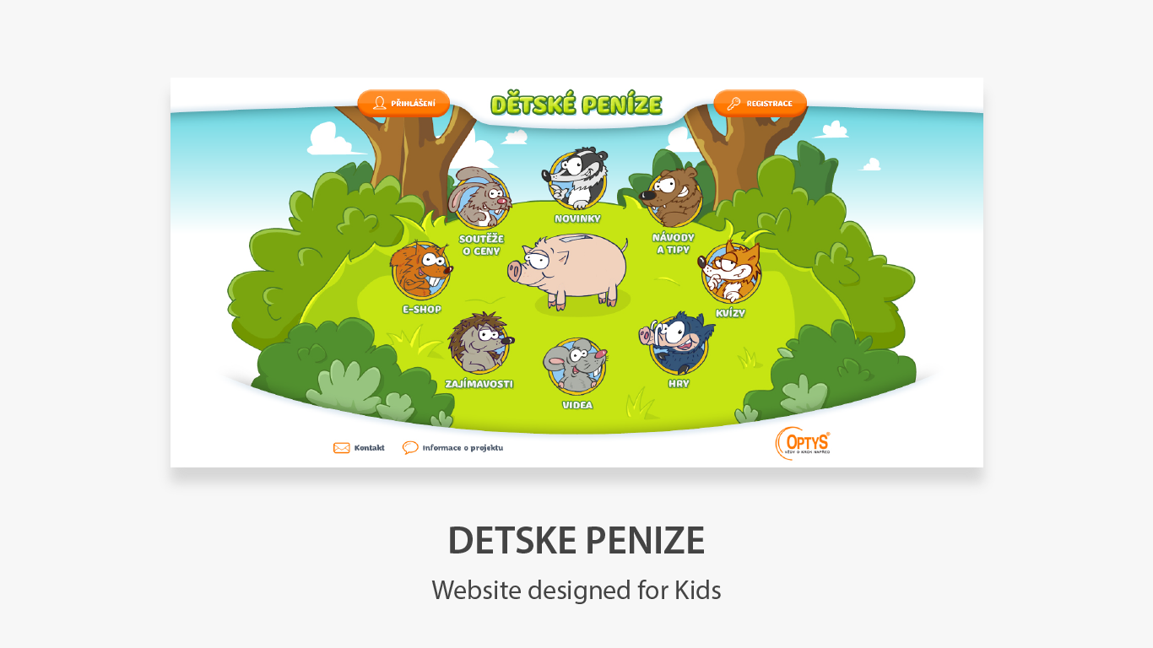

Slide 13


Slide 14
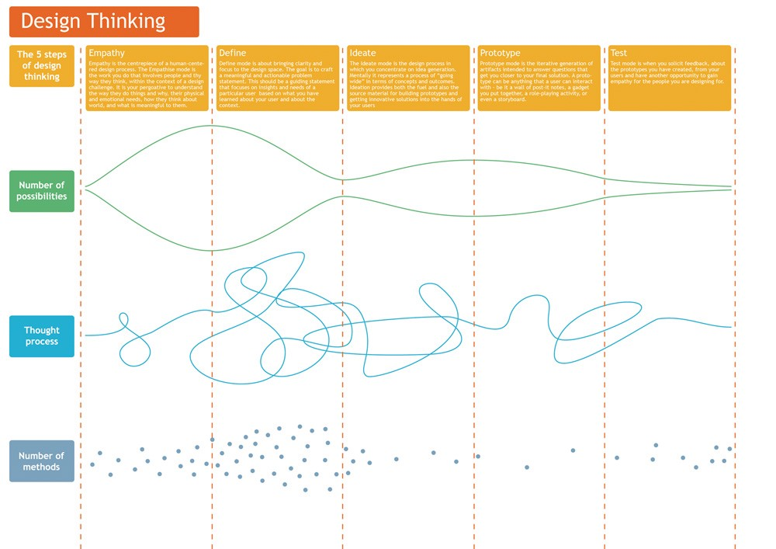

Slide 15

the idea of an individual using an SMS service to communicate with a small group ‘a short burst of inconsequential information’

Slide 16
Information Architecture

Slide 17
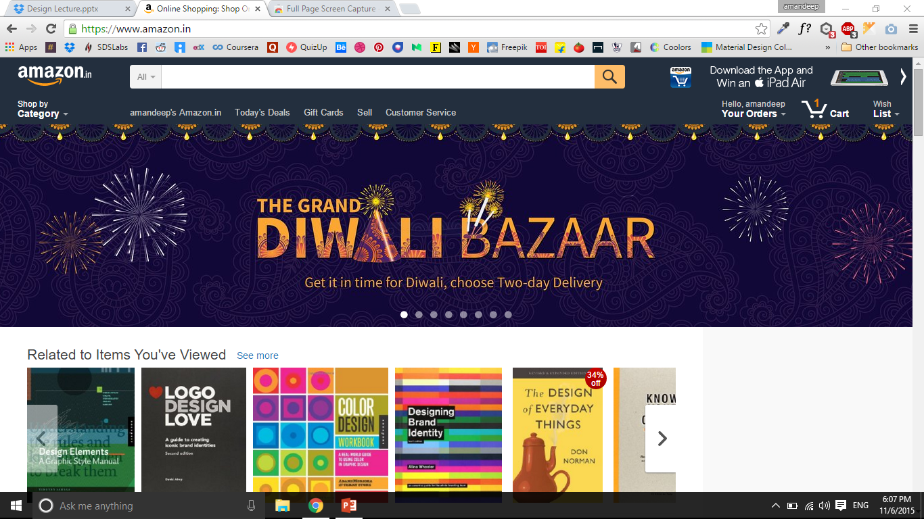

Slide 18
Components Of IA
Organization Schemes and Structures: How you categorize and structure information
Labeling Systems: How you represent information
Navigation Systems: How users browse or move through information
Search Systems: How users look for information

Slide 19
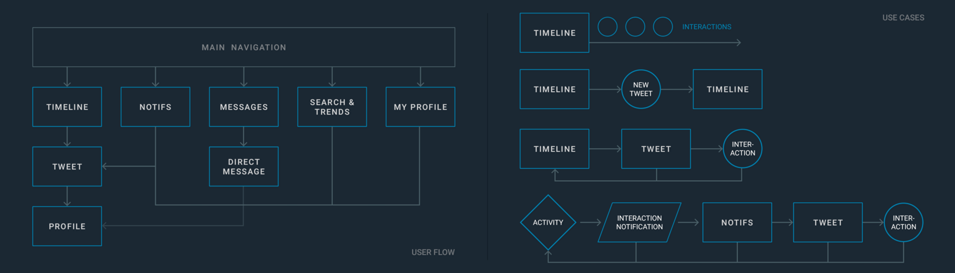

Slide 20
Wire-framing/ Sketching
The wireframe depicts the page layout or arrangement of the website’s content, including interface elements and navigational systems, and how they work together. The wireframe usually lacks typographic style, colour, or graphics, since the main focus lies in functionality, behaviour, and priority of content.c

Slide 21
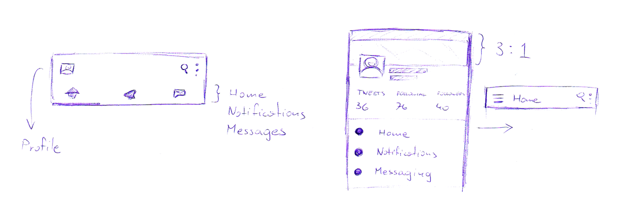
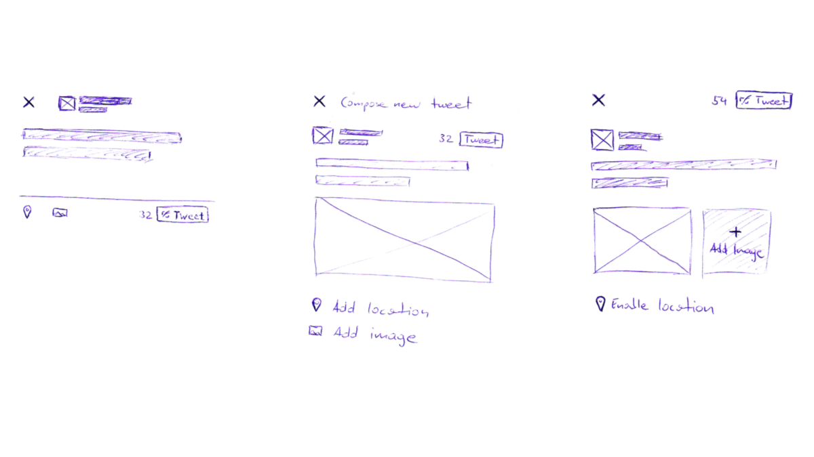
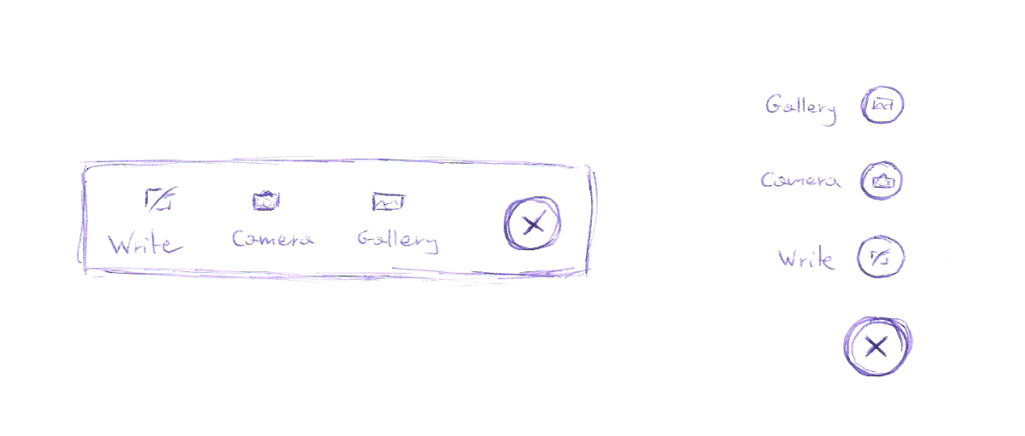

Slide 22
UI (User Interface) - Low Fidelity Mock-ups - Colour Theory - High Fidelity Mock-ups

Slide 23
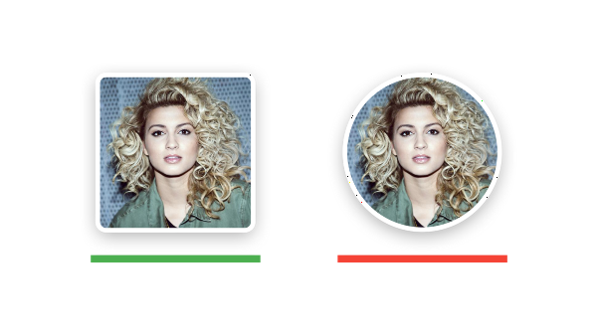
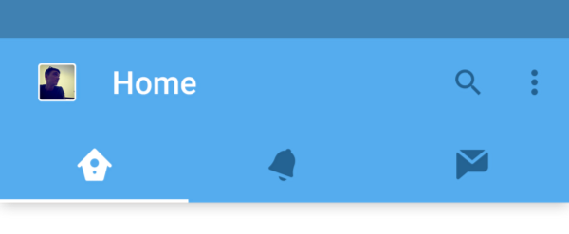
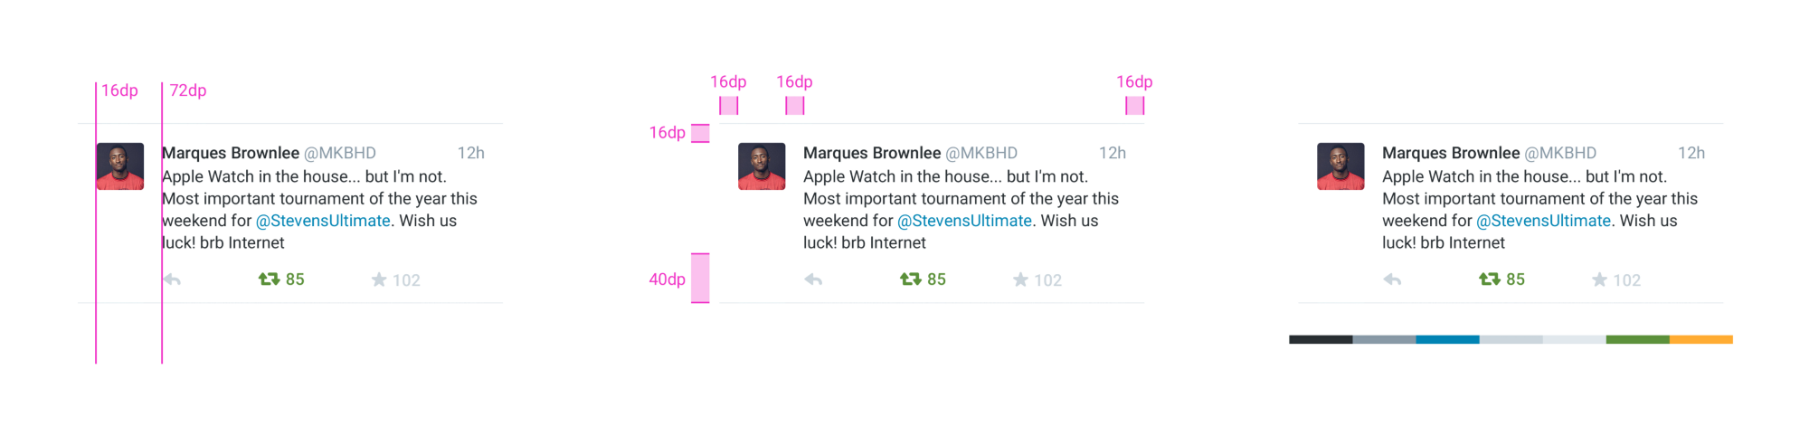

Slide 24
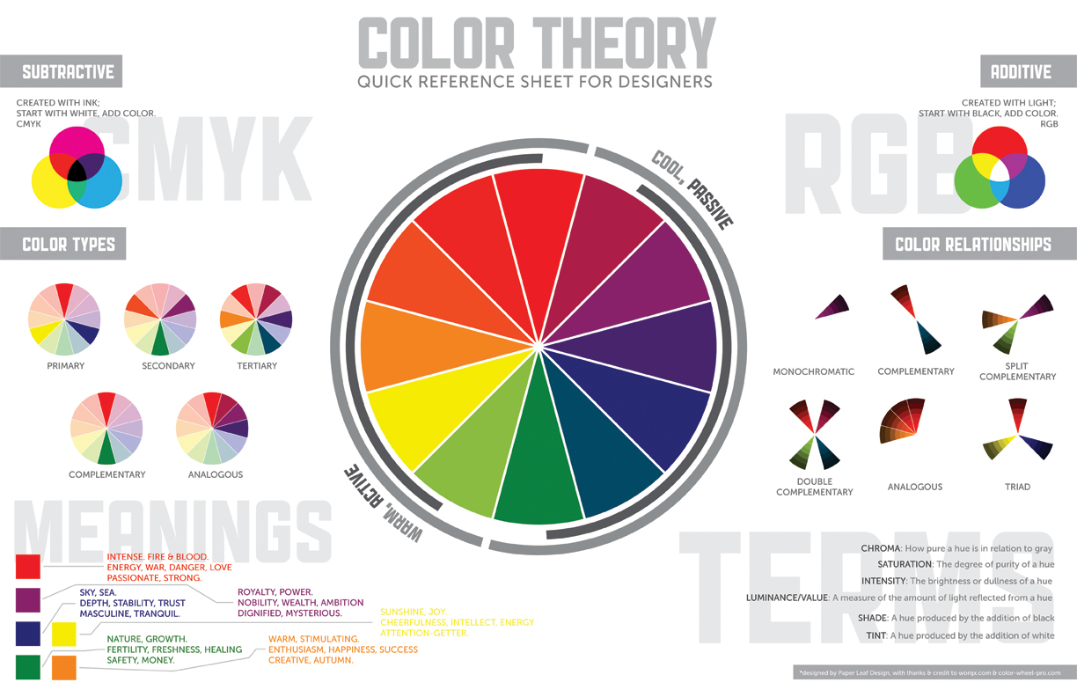

Slide 25
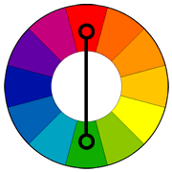
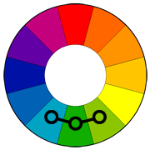
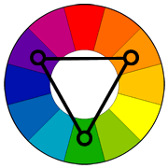
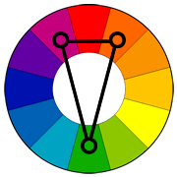
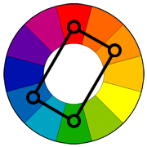
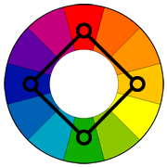
Complementary
Analogous
Triad
Split Complementary
Rectangle
Square

Slide 26
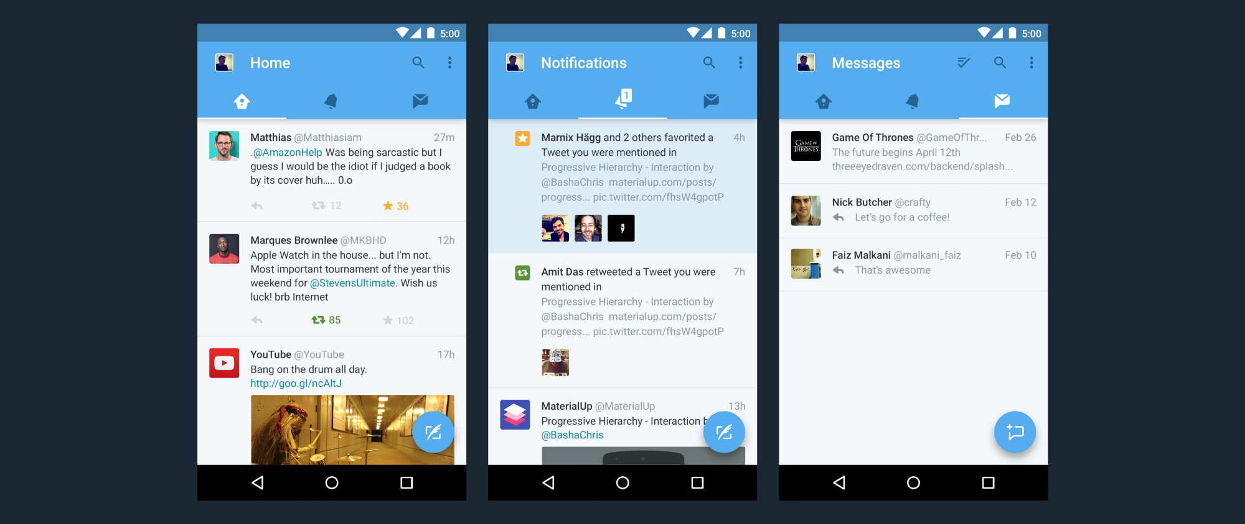
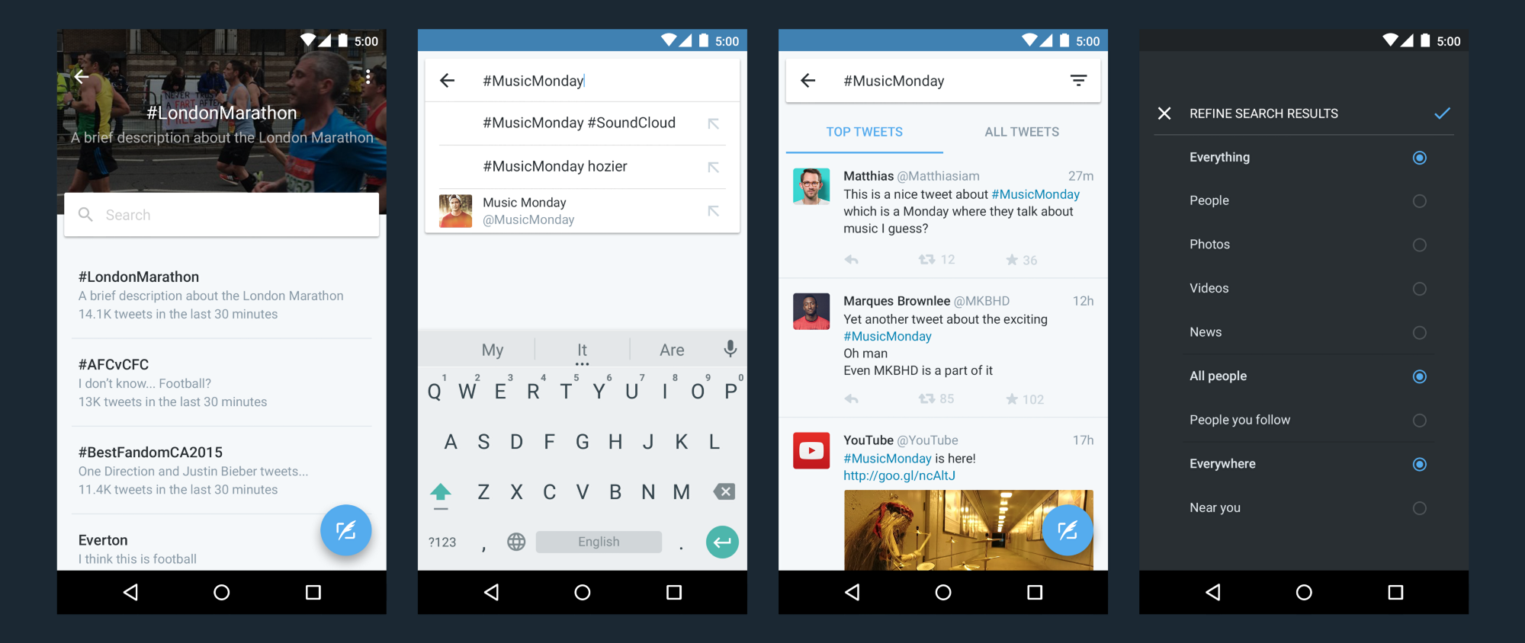

Slide 27
Prototyping

Slide 28
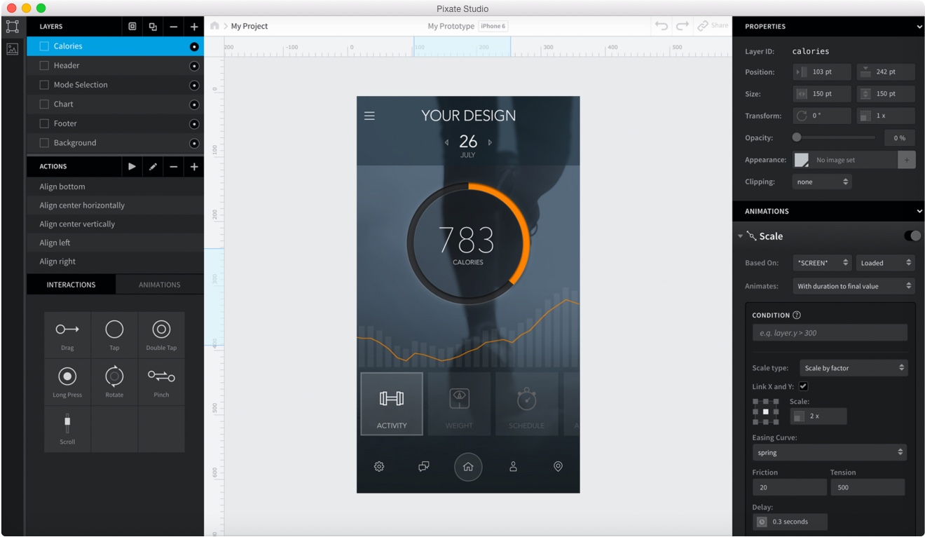

Slide 29



Some popular tools-
Framerjs
Pixate
Invision

Slide 30
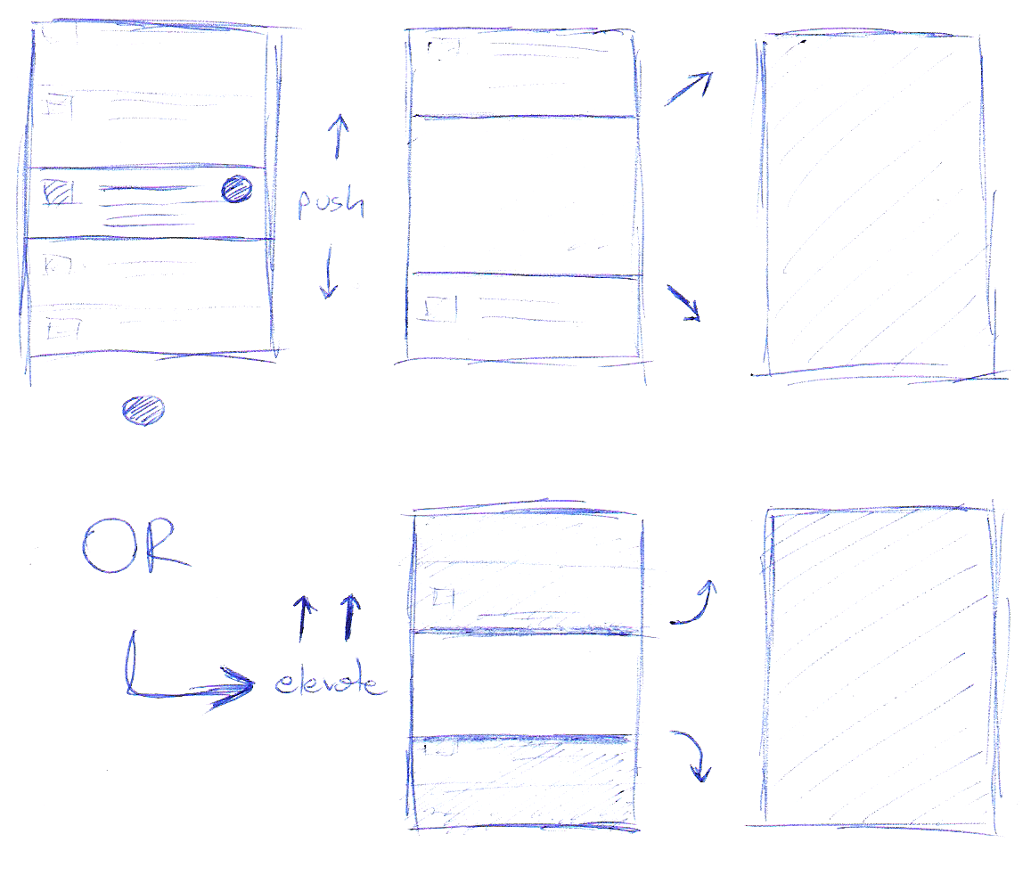
Interactions

Slide 31
User Testing
Before you launch your app, watch real people use it and hear their respective comments… And re-structure accordingly.

Slide 32
Shoot your doubts at:
chat.sdslabs.co
facebook.com/SDSLabs
Twitter- @sdslabs

Slide 33
Thank You.

